Slide 1
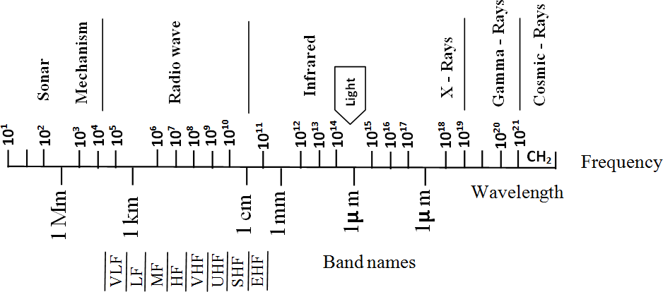
Antenna and Wave Propagation Introduction & Definition
Electromagnetic Spectrum
In environment of the earth, electromagnetic wave propagation depends on their properties as well as on the environment. Since the various methods of propagation depend largely on frequency, we should have an idea about the electromagnetic spectrum.
The complete electromagnetic spectrum is shown in figure below:-
Figure: Electromagnetic Spectrum
The electromagnetic waves can travel in various modes: as a voltage or current through wires, as radio emission through air or the vacuum in space or as light for all
modes, the same basic laws of physics apply. The simplest and most important of these laws relates the wavelength. The wavelength is given by the following law:
Velocity
Wavelength = _{Frequncy}
Electromagnetic energy normally travels in a straight line, but the wave propagation in this straight line can be changed by various methods. The total span of frequencies and corresponding wavelengths used in communication systems is called the electromagnetic spectrum.
The allocation of the communication services within the overall spectrum is made by general worldwide agreement under the control of the International

Slide 2
Antenna and Wave Propagation Introduction & Definition
Telecommunication Union (ITU). In United States, the Federal Communication Commission (FCC) assigns the frequency assignment for free space radio propagation. The total Radio Frequency (RF) spectrum is divided into narrow frequency bands. The different frequency bands designated by the International Consultative Committee (CCIR) are shown in Table below.
Table: CCIR Band Designation
Band No. | Frequency Range | Band | Typical Service
4 | 3 – 30 KHz | VLF | World Wide Telegraphy
5 | 30 – 300 KHz | LF | Long distance point to point service. Marine and navigational aids Broad casting, Navigation...etc.
6 | 300 – 3000 KHz | MF | Broad casting
7 | 3 – 30 MHz | HF | Beamec communication services e.g. moderate and distance communication of all types, short wave broad casting to distant places.
8 | 30 – 300 MHz | VHF | Radar, airplane, navigation, radio relay, Telephony.
9 | 300 – 3000 MHz | UHF | Short distance communication, radar relay system, landing TV.
10 | 3000 – 30000 MHz | SHF | Radar ratio and TV relay links satellite communication (8400- 8500 MHz)
11 | 30000 – 300000 MHz | EHF | Experimental, Amateur, government

